Slide 1
LEARNING MANAGEMENT SYSTEM
Guided By,
Dr J Banumathi
Assistant Professor
Department of Information Technology
University College of Engineering Nagercoil
Presented By,
Aswin R C - 962821205016
Mathumitha M - 962821205033
Muhamad Barhan H - 962821205034
Sahaya Jees S - 962821205047
Department of Information Technology
Final Year
University College of Engineering Nagercoil

Slide 2
Objectives
Build a Unified LMS Platform – Create a centralized system for students, teachers, and admins to manage learning activities.
Enable Seamless Course Management – Allow easy course enrollment, tracking, and access to structured learning pathways.
Automate Attendance and Certification – Implement auto-attendance tracking and certificate generation on course completion.
Personalize the Learning Experience – Provide adaptive learning based on student progress and performance.
Integrate AI Features – Include AI tutor for doubt-solving, smart feedback on learning progress, and code assistance for programming courses.
Support Communication and Collaboration – Add discussion forums for peer interaction and teacher-student communication.

Slide 3
Abstract
This project aims to design and develop a comprehensive Learning Management System (LMS) that offers a seamless digital learning experience by integrating core features such as user authentication, course enrolment, attendance tracking, personalized learning pathways, assessments, evaluations, and certification management — all within a unified and intuitive dashboard.
To enhance engagement and learning efficiency, the system incorporates AI-powered features like:
An AI Tutor that assists students with step-by-step solutions to their doubts.
Smart Progress Analysis to provide personalized feedback and learning predictions.
Code Assist tools to help learners debug and understand programming assignments.

Slide 4
Introduction
The LMS offers features like seamless user authentication, easy course enrollment, and automated attendance tracking. It also facilitates certification management, ensuring that learners can showcase their achievements with digital certificates. The system adapts to each learner’s needs by recommending personalized learning paths based on progress and interests, enhancing engagement and learning outcomes.
An AI-powered tutor provides real-time assistance, especially for coding assignments, making the learning process more interactive and supportive. Additionally, smart progress tracking and real-time feedback are integrated, ensuring continuous improvement for both students and instructors. With clean and intuitive dashboards, users can easily navigate through courses, monitor progress, and track performance.

Slide 5
Literature Survey
1. Coursera: AI-Powered Personalization and Adaptive Learning
Published: 2023
Summary: Coursera’s LMS integrates AI to offer personalized learning paths. By analyzing student behaviors, such as quiz results and course completion rates, Coursera customizes content delivery.
Key Feature: AI-driven course recommendations and adaptive learning. (coursera.org)
2.eTutor: School LMS Trends
Published: 2025
Summary: eTutor identifies top school LMS trends, including blended and hybrid learning models, gamification, and real-time progress tracking. These trends aim to deliver dynamic and engaging tasks, improve student retention rates, and provide a more flexible and adaptable learning environment.

Slide 6
Literature Survey
3. Udemy: Scalable and Flexible Online Learning for Diverse Audiences
Published: 2023
Summary: The platform’s advanced user interface (UI) is designed to be intuitive, ensuring users can access courses and materials with ease. Additionally, Udemy’s integration of social learning features like peer discussions enhances interactivity among learners.
Key Feature: Massive open online course (MOOC) model with course creation tools for instructors. (udemy.com)
4. Moodle: Open-Source LMS with Customizable Features
Published: 2023
Summary: Moodle is an open-source LMS used by educational institutions worldwide. The system supports both asynchronous and synchronous learning.
Key Feature: Open-source nature with high customization options for various educational needs. (moodle.org) analytics for personalized feedback and course optimization. (blackboard.com)

Slide 7
Literature Survey
5. Blackboard: Unified Learning Experience with Data Analytics
Authors: Blackboard Research Team
Published: 2023
Summary: Blackboard offers a robust learning management platform widely used in higher education. It integrates learning analytics, enabling instructors to track student progress and provide tailored interventions. The platform includes features such as mobile learning, discussion boards, and grade tracking. Blackboard's data-driven approach helps in making informed decisions about curriculum design and student support.
Key Feature: Advanced learning
6. Kira Learning: AI-Driven Teaching Assistants
Published: April 2025
Summary: Kira Learning, founded by Andrew Ng, utilizes AI agents to assist educators by automating grading, lesson planning, and analyzing student performance. This approach allows teachers to focus on personalized instruction and mentoring. The platform has been implemented in various school districts, aiming to reduce teacher workload and enhance educational outcomes.

Slide 8
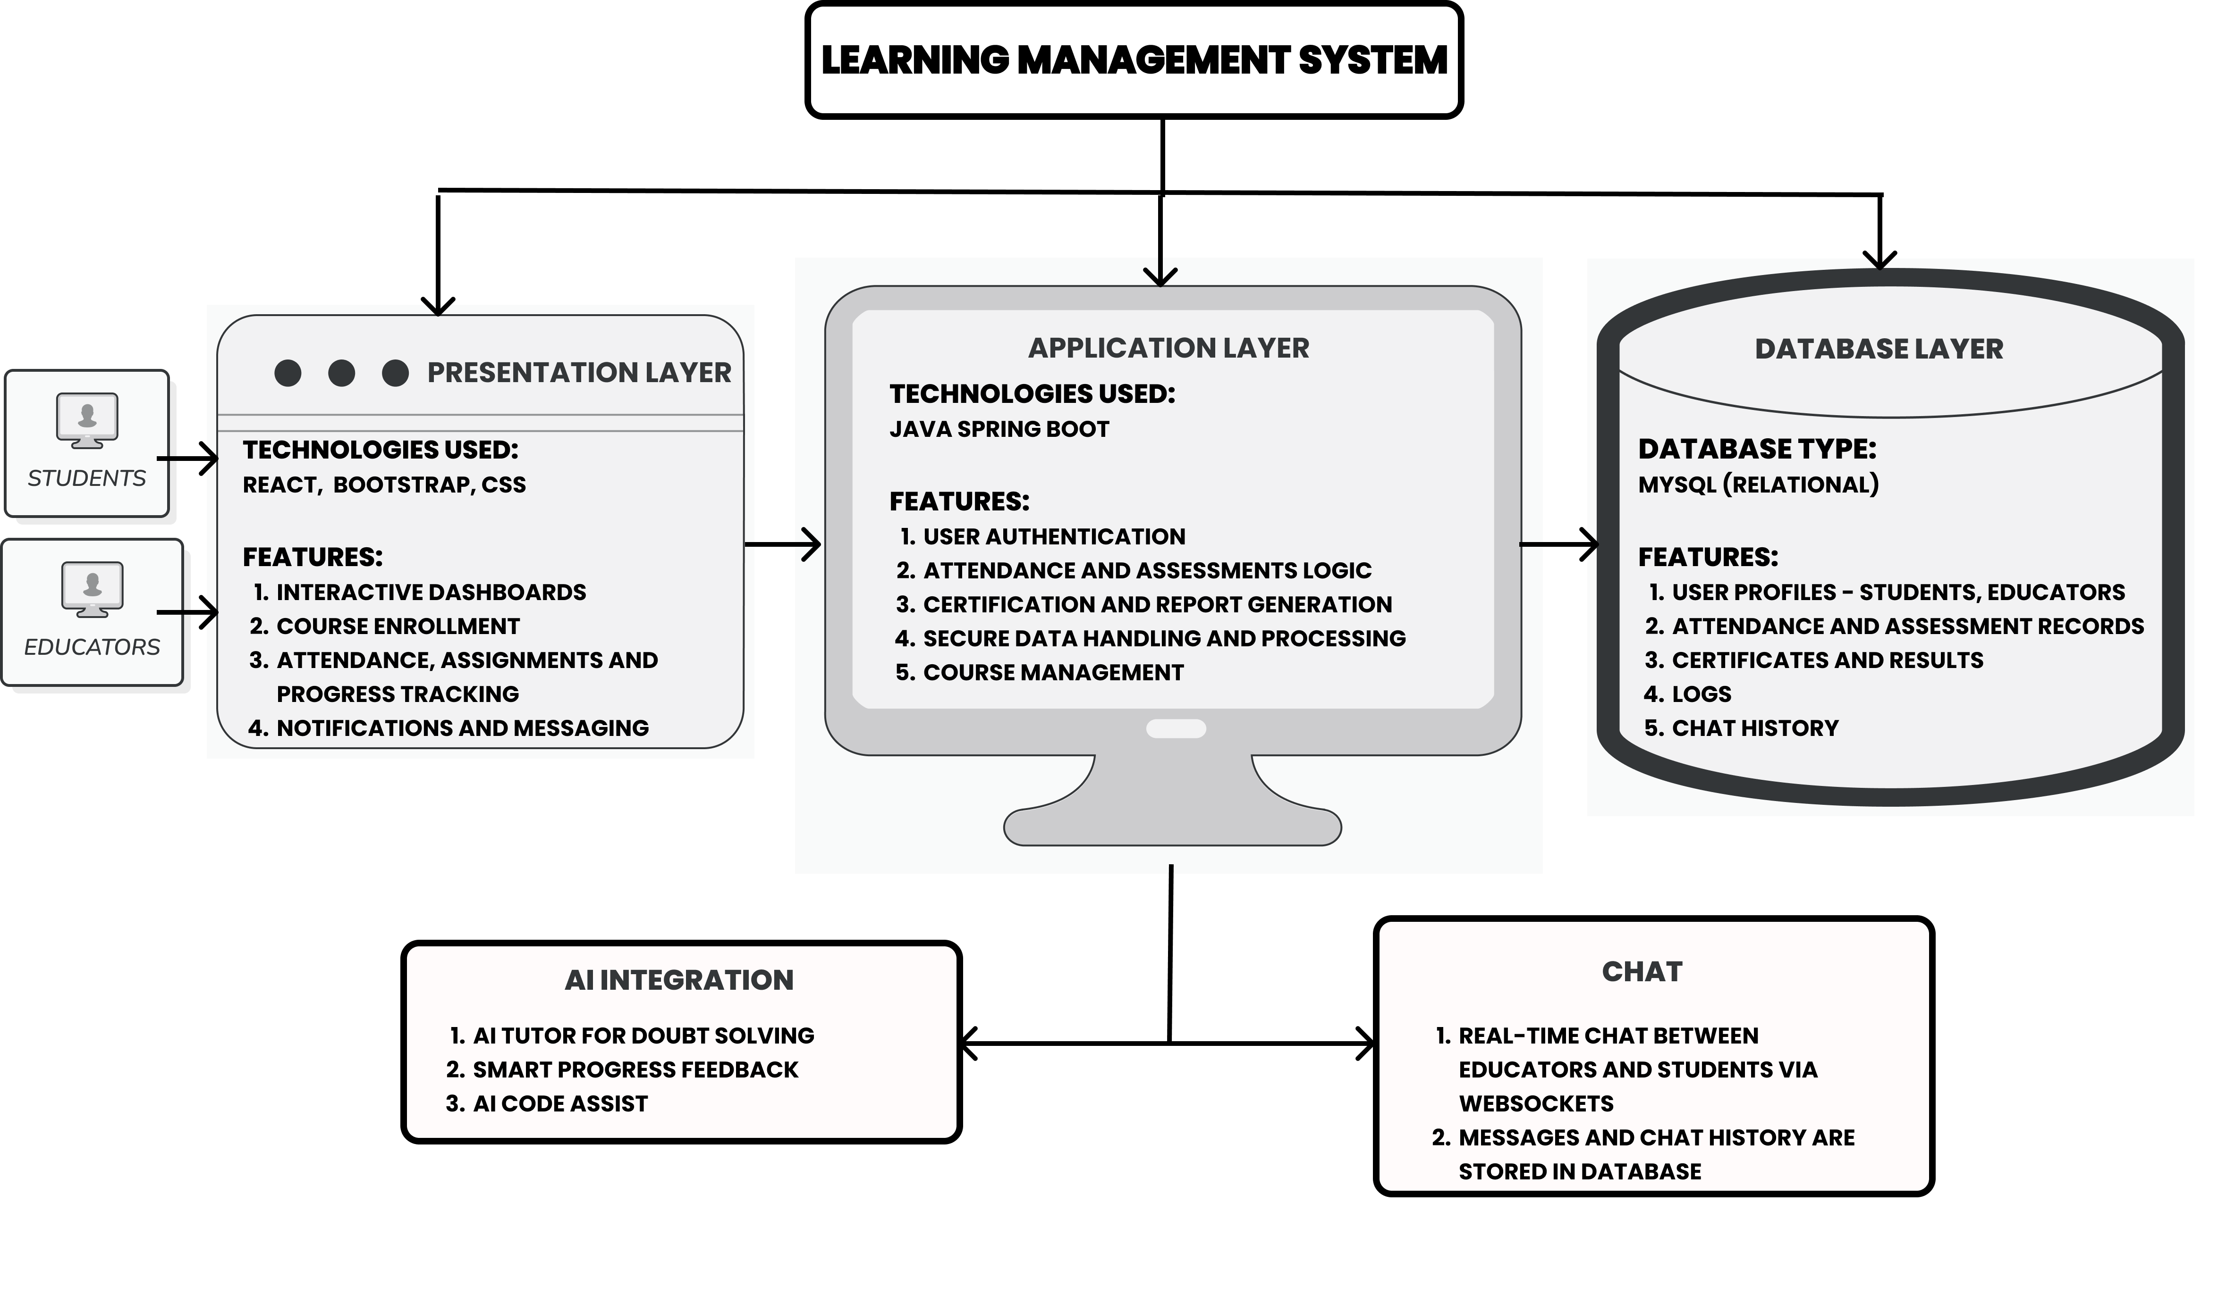
System Architecture

Slide 9
Existing Systems
Moodle:
An open-source LMS widely used in schools, colleges, and universities.
Google Classroom:
A simple, free LMS integrated with Google Workspace for Education.
Coursera for Campus:
Provides online courses and certificates from universities globally.
Edmodo:
A social media-like LMS used mainly in K–12 education.
TalentLMS:
A corporate-focused LMS used for training employees and onboarding.

Slide 10
Disadvantages of Existing System
Dependence on Traditional Learning Methods
Manual attendance tracking and paper-based systems
Time-consuming and prone to errors
Lack of Centralized Progress Tracking
No integrated system to monitor student performance and assessments
Difficulty in identifying students' strengths and weaknesses
Limited Accessibility & User Engagement
Platforms often lack mobile-friendly or intuitive interfaces
Lower user interaction and engagement in the learning process
Inconsistent Certification Management
Lack of automated or standardized certification issuance
Difficulty in tracking and verifying certifications

Slide 11
Proposed System
To address the need for an efficient and comprehensive Learning Management System (LMS), we propose a centralized and user-friendly platform that integrates key educational features.
Seamless User Management: Secure individual user logins for students, educators, and admins.
Course Enrollment & Tracking: Easy course registration and structured learning pathways.
Automated Attendance System: Tracks student participation efficiently.
Personalized Learning: Adaptive learning pathways tailored to individual progress.
Assessments & Evaluations: Integrated quizzes, tests, and real-time performance tracking.
Certification Management: Automated generation and verification of course completion certificates.
Intuitive Dashboard: A unified interface for managing courses, progress, and reports.
AI Assistance: AI Tutor for smart doubt solving and smart feedback mechanisms.

Slide 12
Advantages of Proposed System
Personalized and Adaptive Learning Experience:
Automatically adjusts learning flow based on user pace and performance.
Skipped or fast-tracked topics trigger quizzes to ensure understanding before progressing.
AI tutor provides real-time doubt resolution and resource recommendations.
Smart Attendance and Progress Tracking:
Attendance is calculated based on video completion and quiz performance, not just login time.
Visual progress tracking helps students and teachers monitor completion, speed, and engagement.
Engaging Interaction through Discussion and AI Support:
Each course includes discussion forums and Q&A with instructors.
AI chatbot supports continuous learning, answering queries even outside class hours.
Separate Dashboards for Teachers and Students:
Teachers manage courses, track progress, answer doubts, and post announcements.
Students can explore courses, ask questions, and track their journey clearly.

Slide 13
Methodology
Requirement Analysis and Planning:
Gathered requirements from students and teachers through surveys and interviews.
Identified key gaps in existing LMS platforms, especially in personalization, feedback, and secure assessments.
Planned project phases with Gantt chart and task-wise division.
UI/UX Design and Prototyping:
Designed intuitive dashboards and course pages using Figma for both students and educators.
Ensured accessibility, responsiveness, and seamless navigation for web-based learning.
Modular Frontend and Backend Development:
Frontend: Developed using React.js, with dynamic components for videos, discussions, progress bars, and quizzes.
Backend: Created REST APIs using Spring Boot; handled data processing, user authentication, and assessments.
Database: MySQL used to manage user profiles, course data, logs, attendance, and progress metrics.

Slide 14
Methodology
Smart Features Integration:
AI Tutor: Integrated chatbot to answer user queries and guide learning.
Progress Feedback: Real-time progress tracking with feedback based on quiz results and video completion.
Quiz Rules: Implemented monitoring logic to restrict tab switching, copying, with auto-submit after 3 violations.
Testing, Feedback, and Iteration:
Conducted functional and usability testing with a group of users.Fixed bugs and refined features based on user feedback.
Performance tested on multiple devices and browsers.

Slide 15
Algorithms / Techniques Used
Progress Tracking Algorithm:
Tracks video completion, quiz results, and time spent on modules.
Progress is updated only if a video is watched completely or the quiz is passed (if skipped).
Attendance Logic:
Marks daily attendance based on course interaction (video watch + quiz attempt).
Early completion still counts attendance proportionally based on quiz completion and performance.
AI Tutor (Chatbot):
Uses Gemini API.
Anti-Cheating Mechanism (Quiz Rules):
JavaScript-based tab switch detection and clipboard monitoring.
Timer logic with 3-warning system; quiz auto-submits on rule violation.
User Authentication and Real time chat:
Firebase user authentication and firebase firestore ( real-time database ) for implementing real time chat for students and instrctors.

Slide 16
Technology Stack:
Layer | Technology / Tool
Frontend | ReactJS + Vite, Bootstrap V5, CSS
Backend | Java Spring Boot (REST APIs)
Database | MySQL
Design & Prototyping | Figma
Version Control | Git, GitHub
Quiz Monitoring | JavaScript (tab switch/copy-detect scripts)
AI Integration | Gemini API
Communication | Firebase Firestore for real-time chat
Postman | For testing backend APIs

Slide 17
Functional Requirements
Non-Functional Requirements
User Registration and Login
Course Enrollment and Tracking
Smart Attendance and Progress Tracking
Quizzes and Final Assessment
AI-based Doubt
Discussion Forums and Q&A
Teacher Dashboard
Real-Time Messaging
Report and Certificate
Performance
Scalability
Security
Reliability
Usability
Maintainability
Portability

Slide 18
Modules and Screenshots

Slide 19
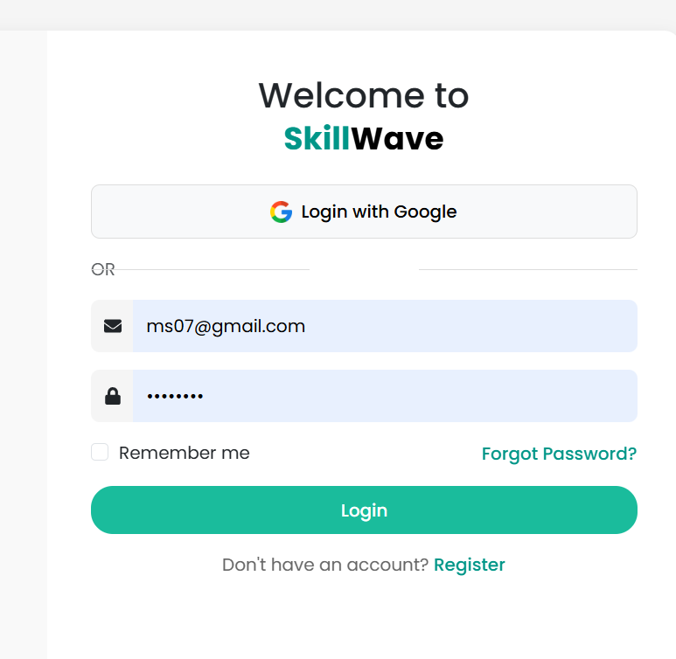
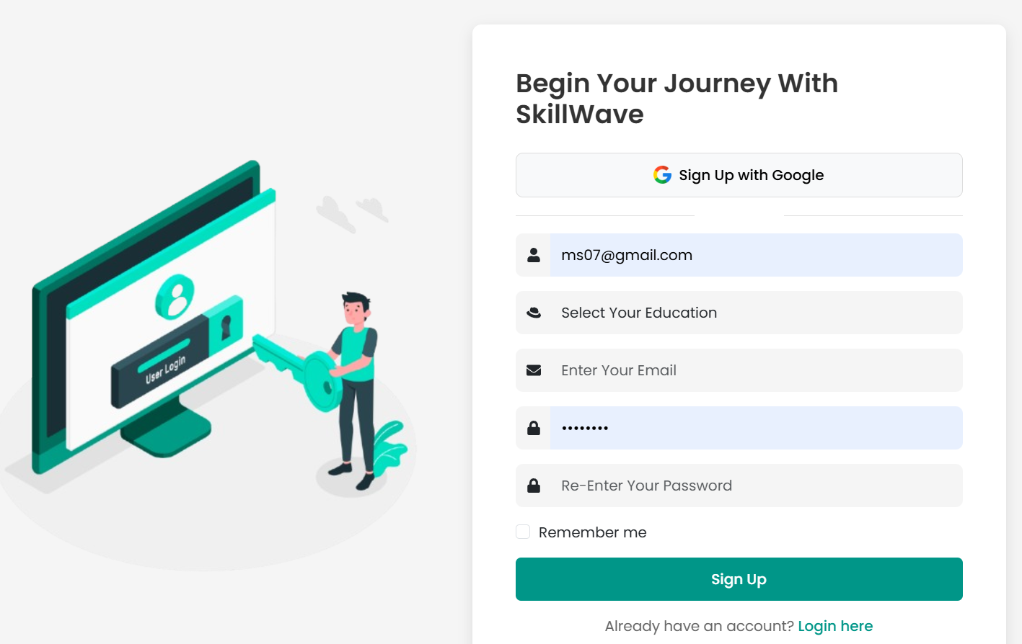
1. User Authentication Module:
Manages secure login, registration, and role-based access for students and teachers.

Slide 20
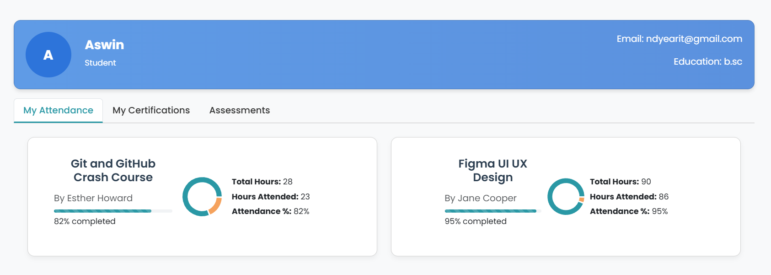
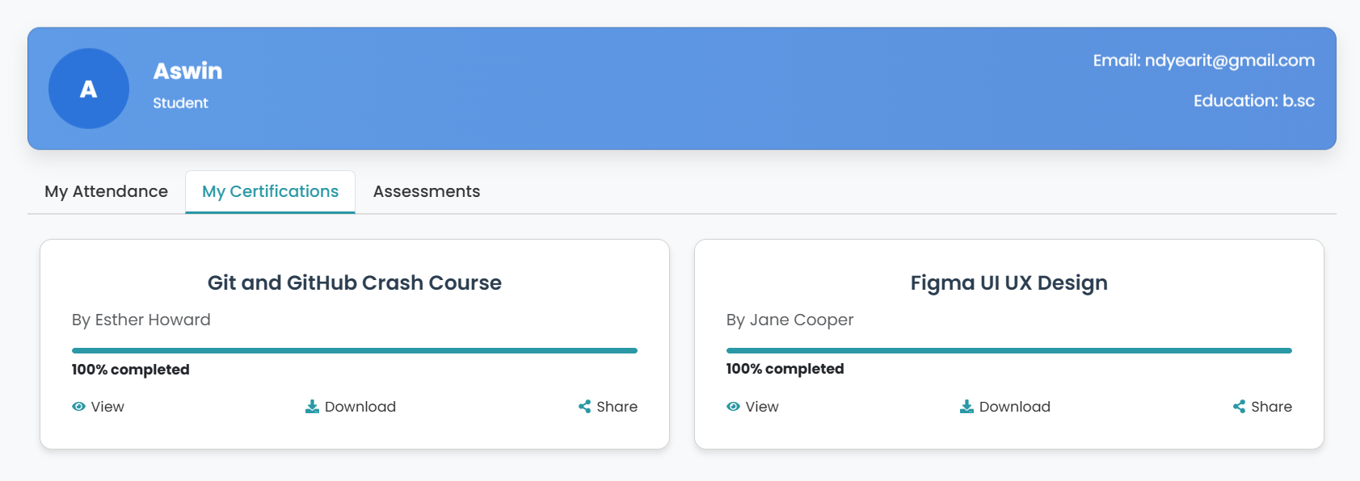
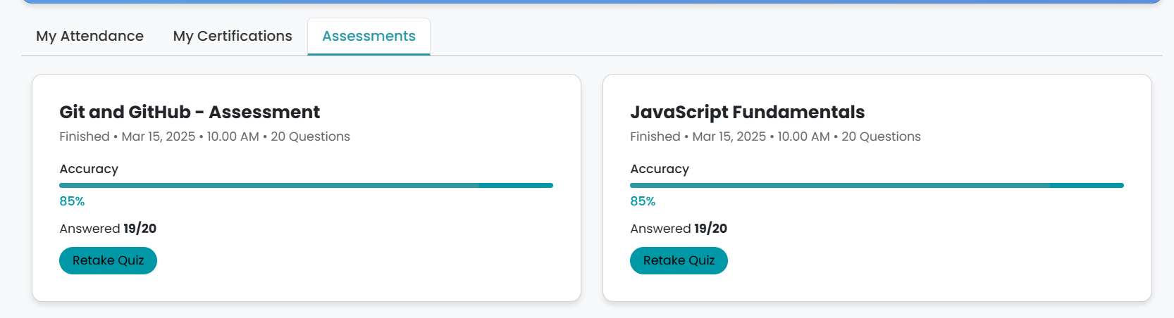
2. User Profile Module: Allows users to view all the attendance records, certifications and assessments records.

Slide 21
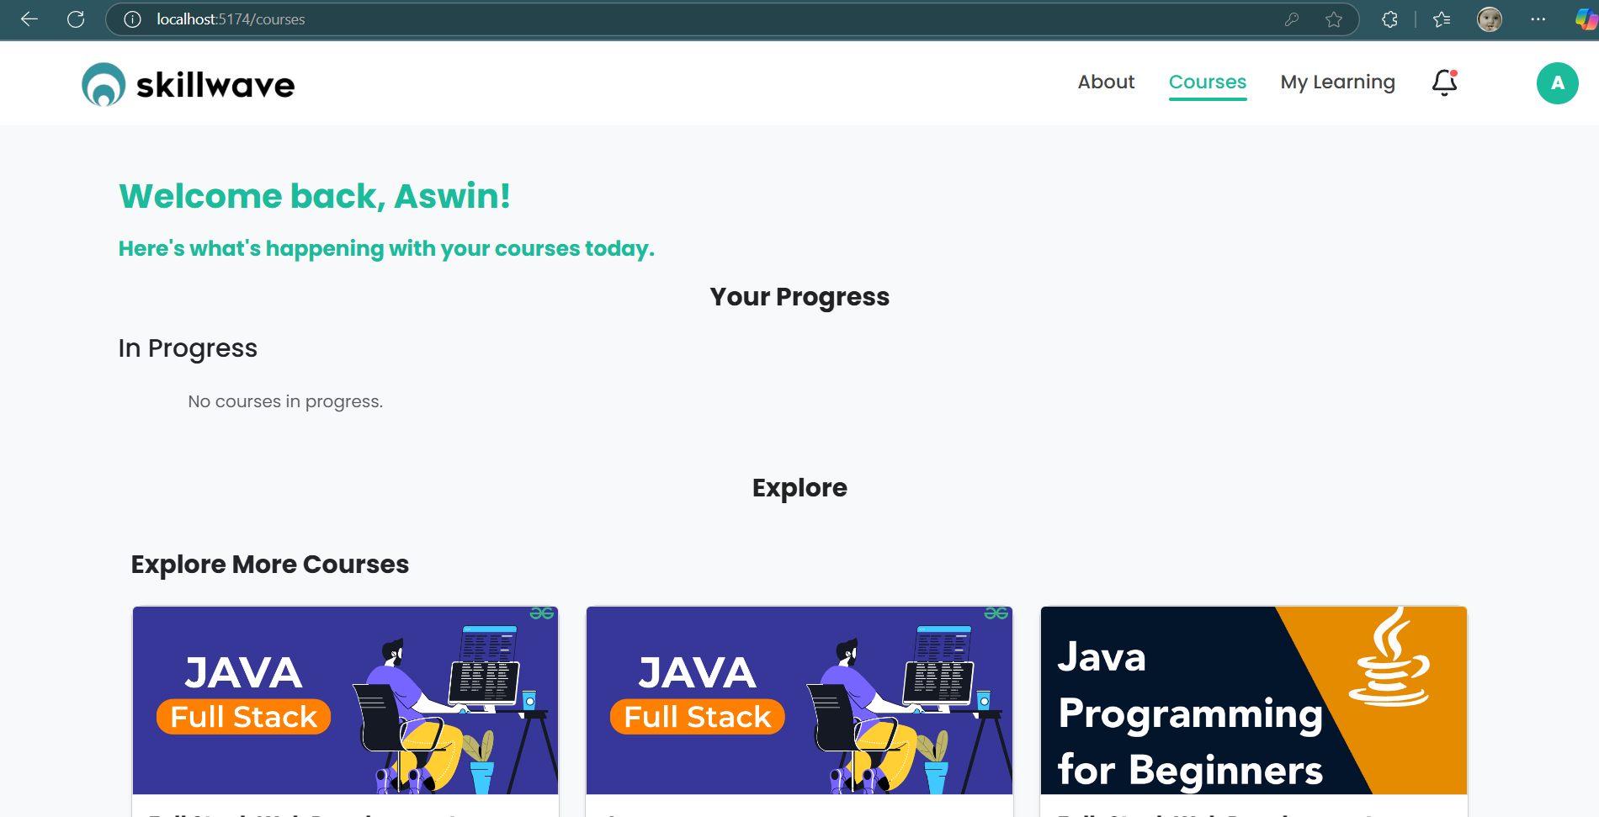
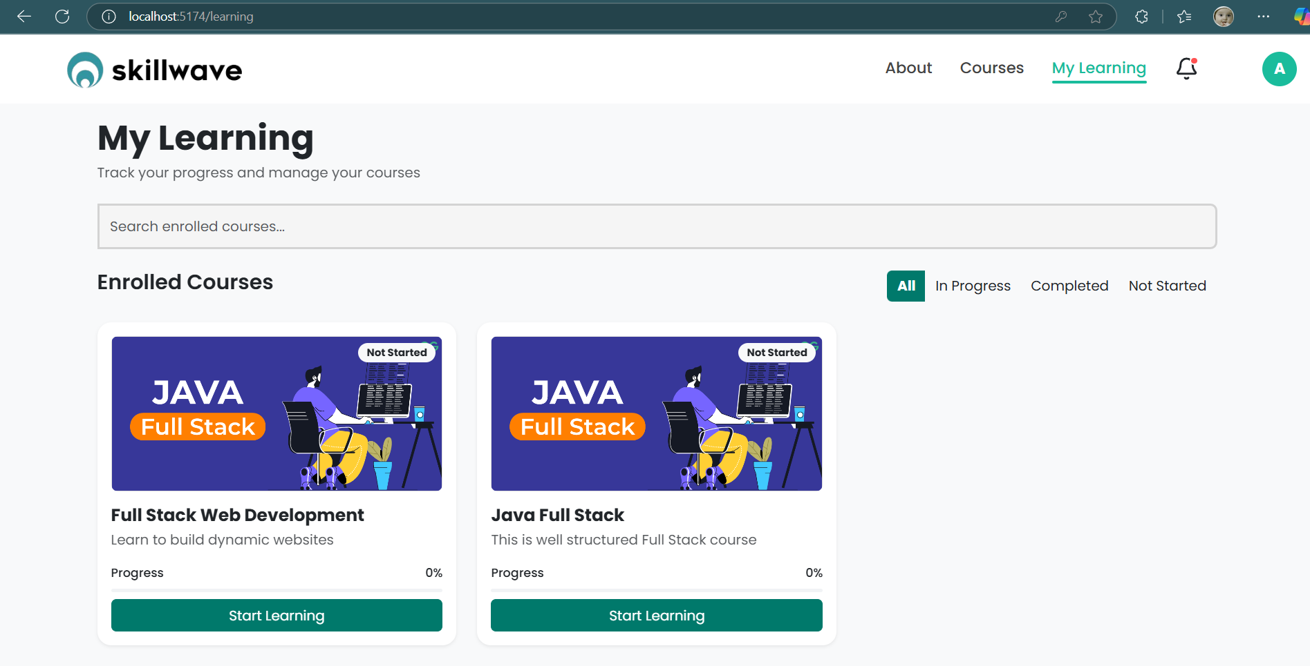
3. Enrolled Courses Module:
Displays a list of courses the user is currently enrolled in with quick access to progress.
4. Browse Courses Module:
Lets users explore all available courses with filters like category, level, and teacher.

Slide 22
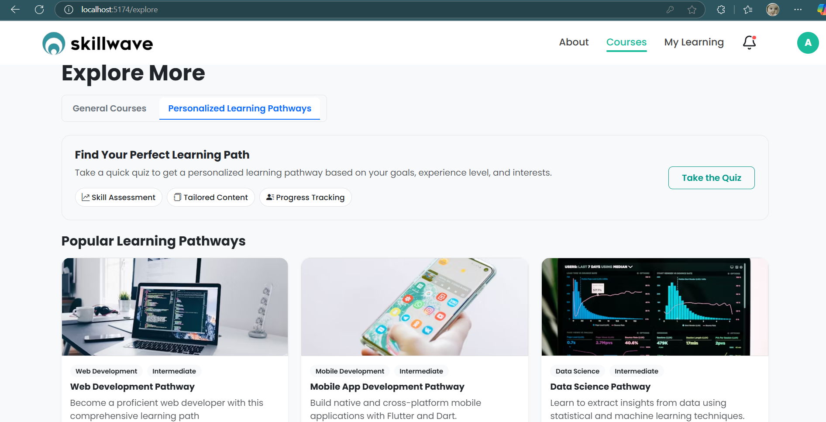
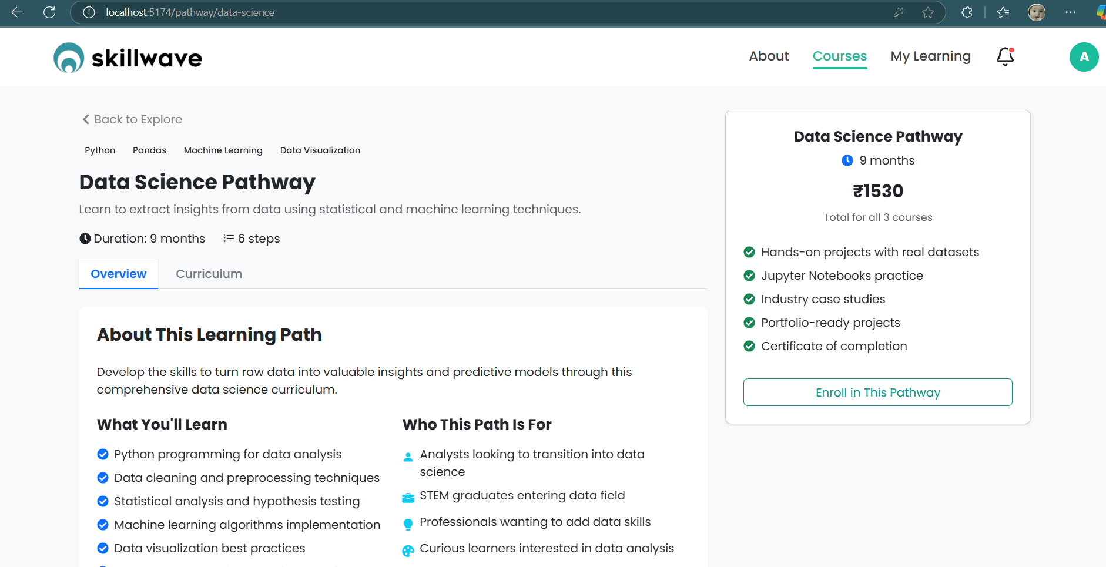
5. Learning Pathway Module:
Provides a structured path for each course including topics, videos, and quizzes in sequence.

Slide 23
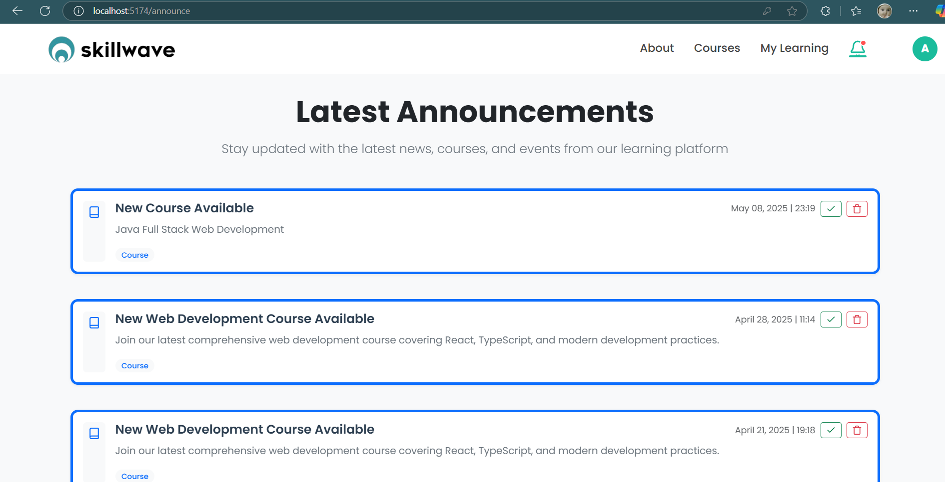
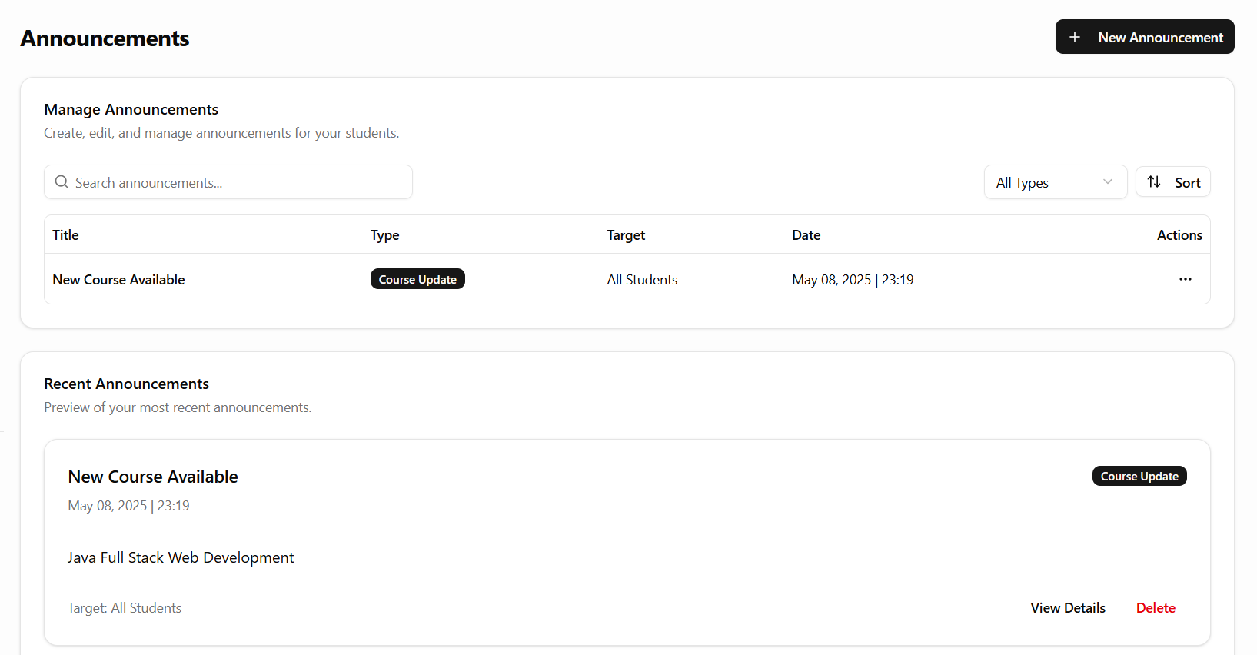
6. Announcement Module:
Instructors can post important course updates visible to all enrolled students.

Slide 24
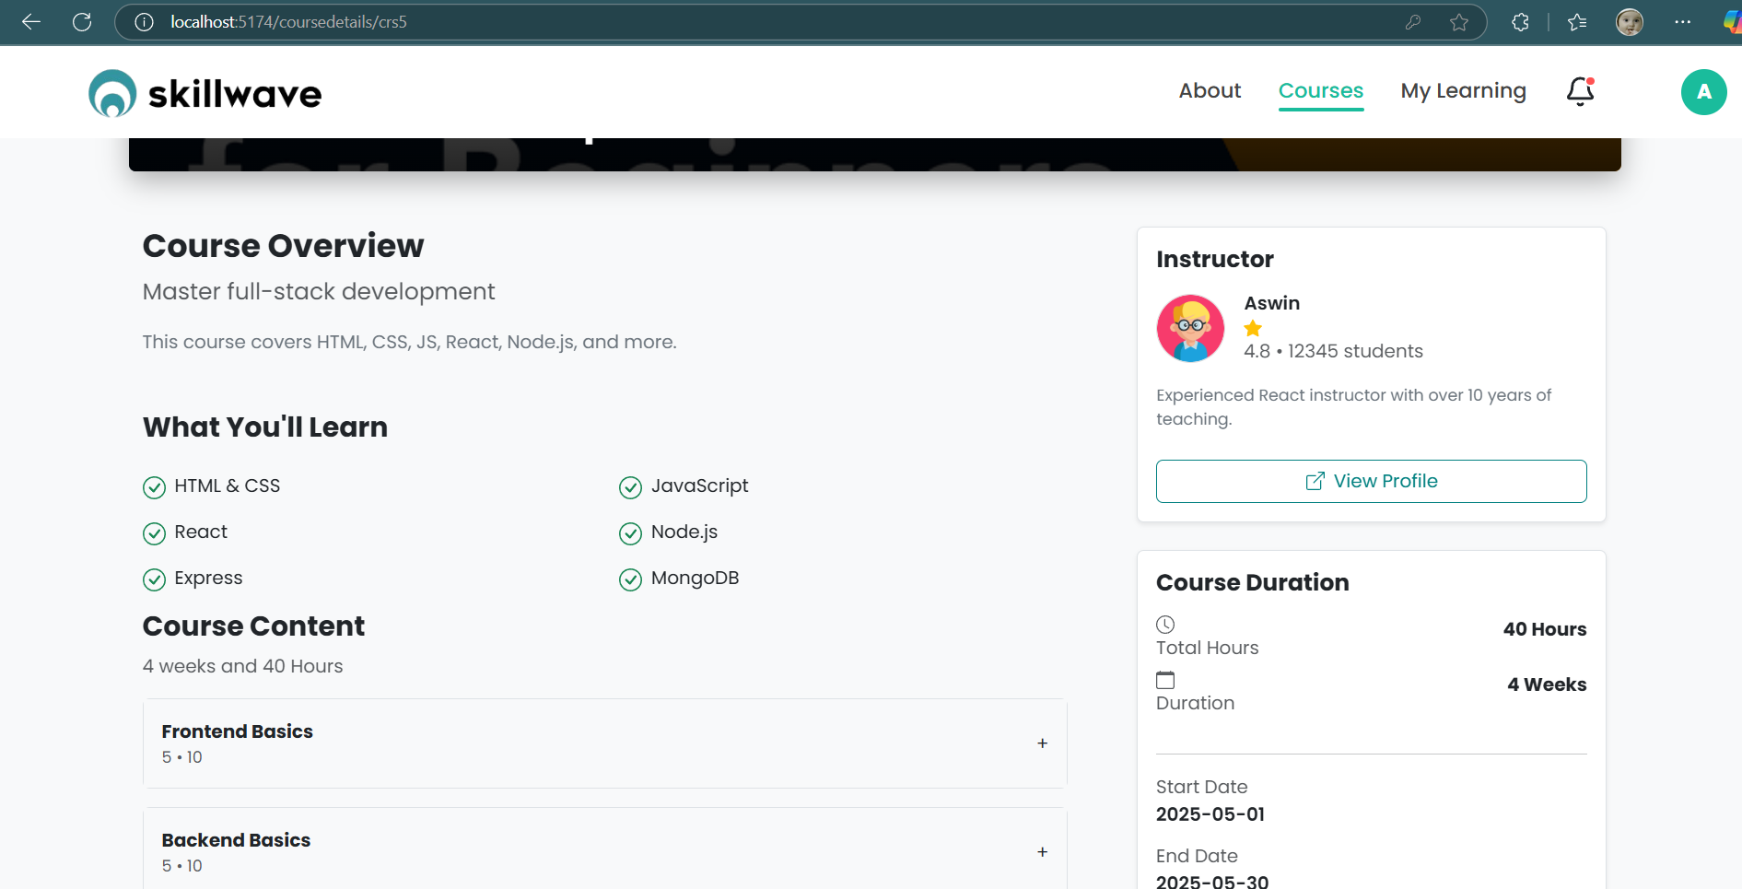
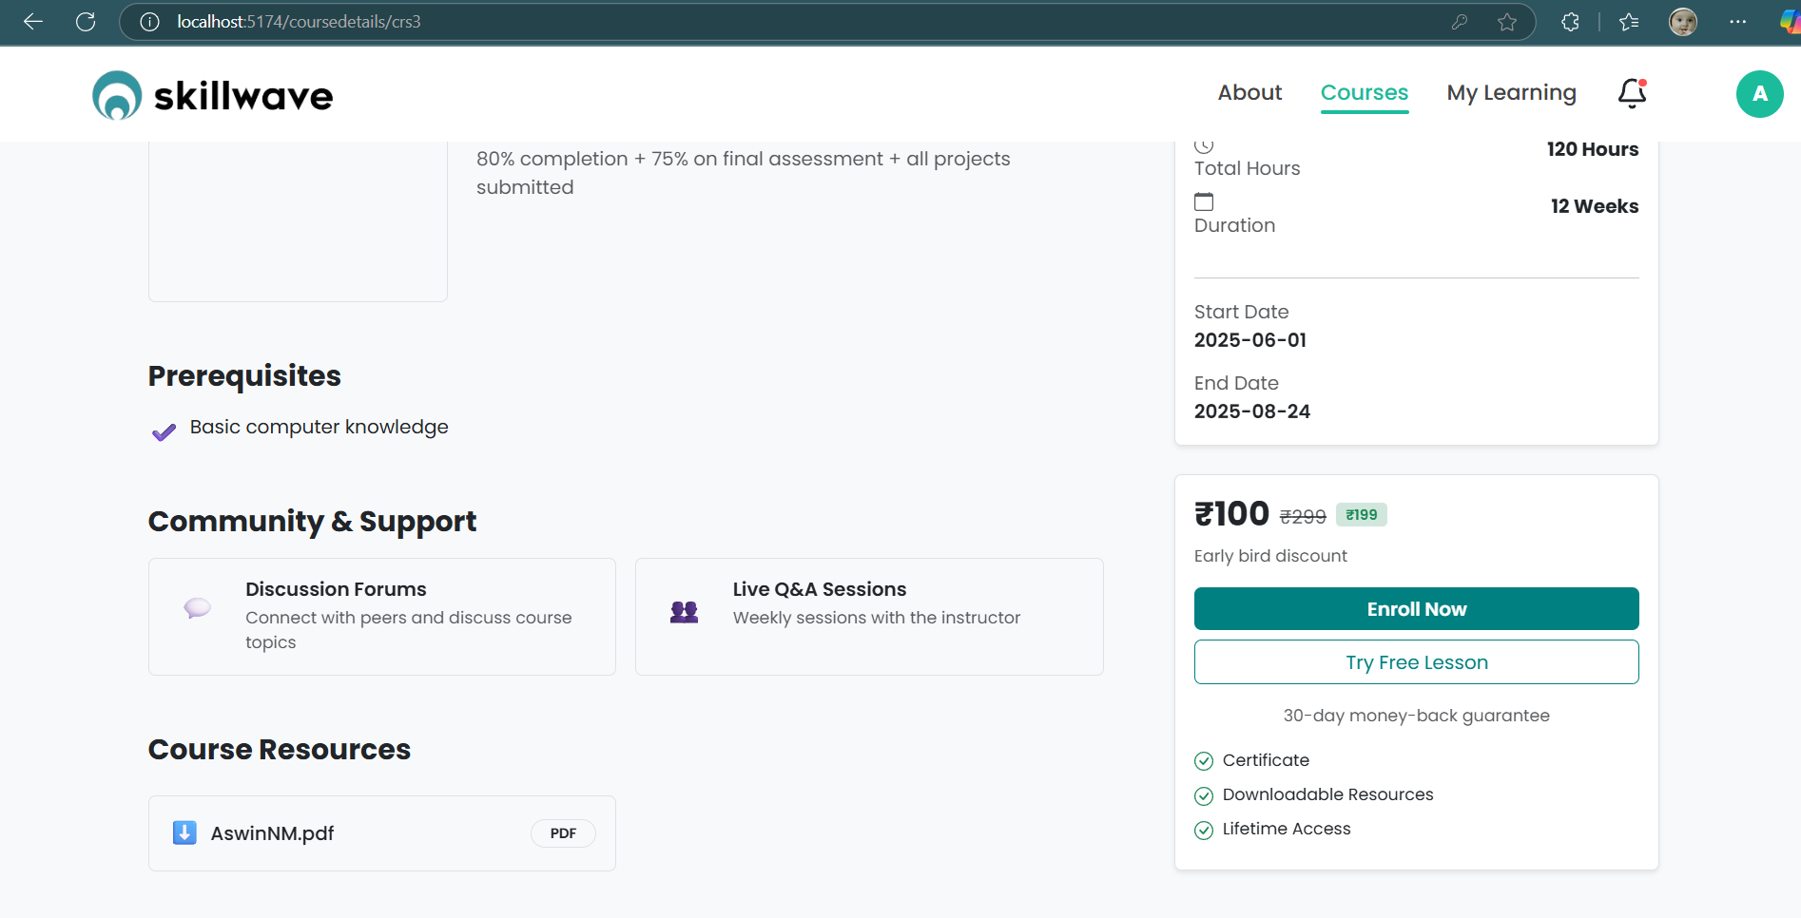
7. Course Details Module:
Shows detailed info about a course—description, topics, duration, instructor, and reviews.

Slide 25
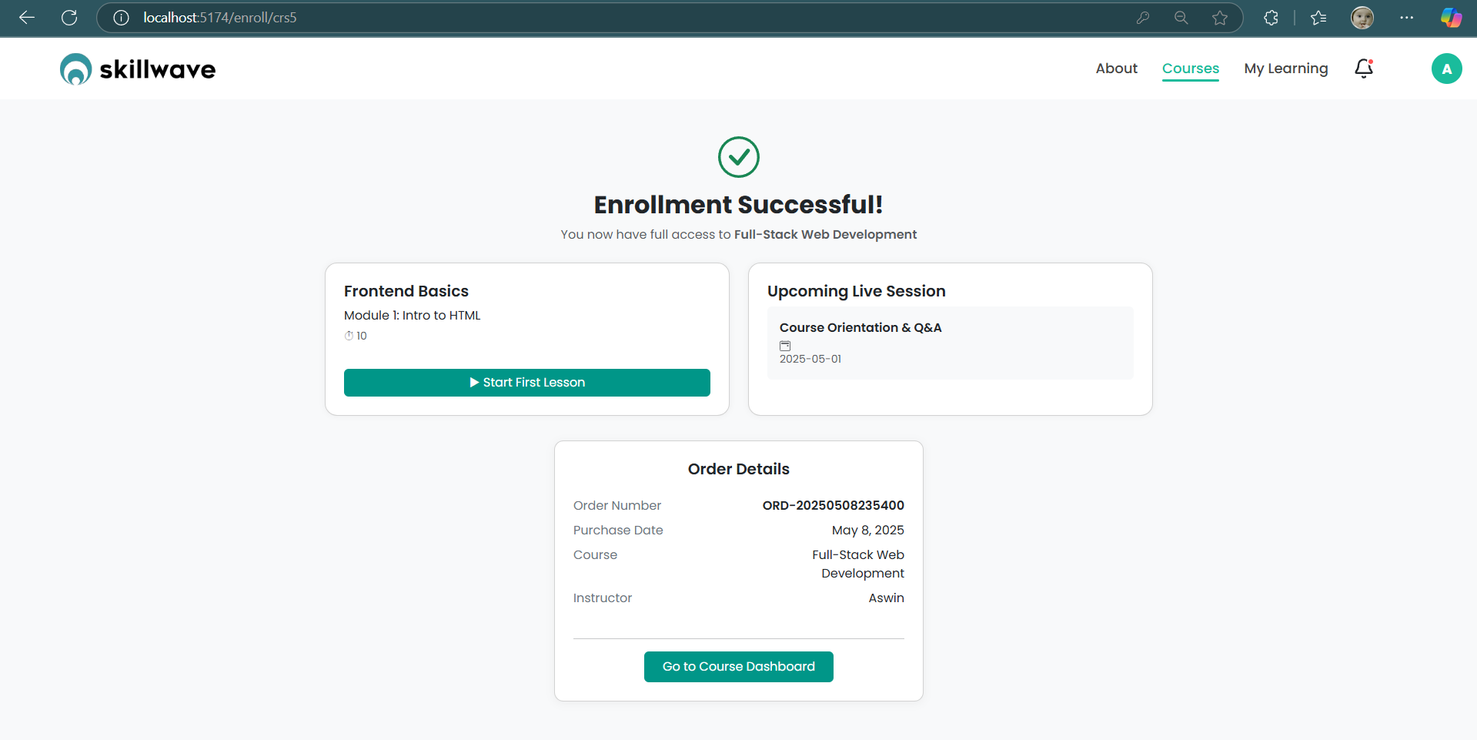
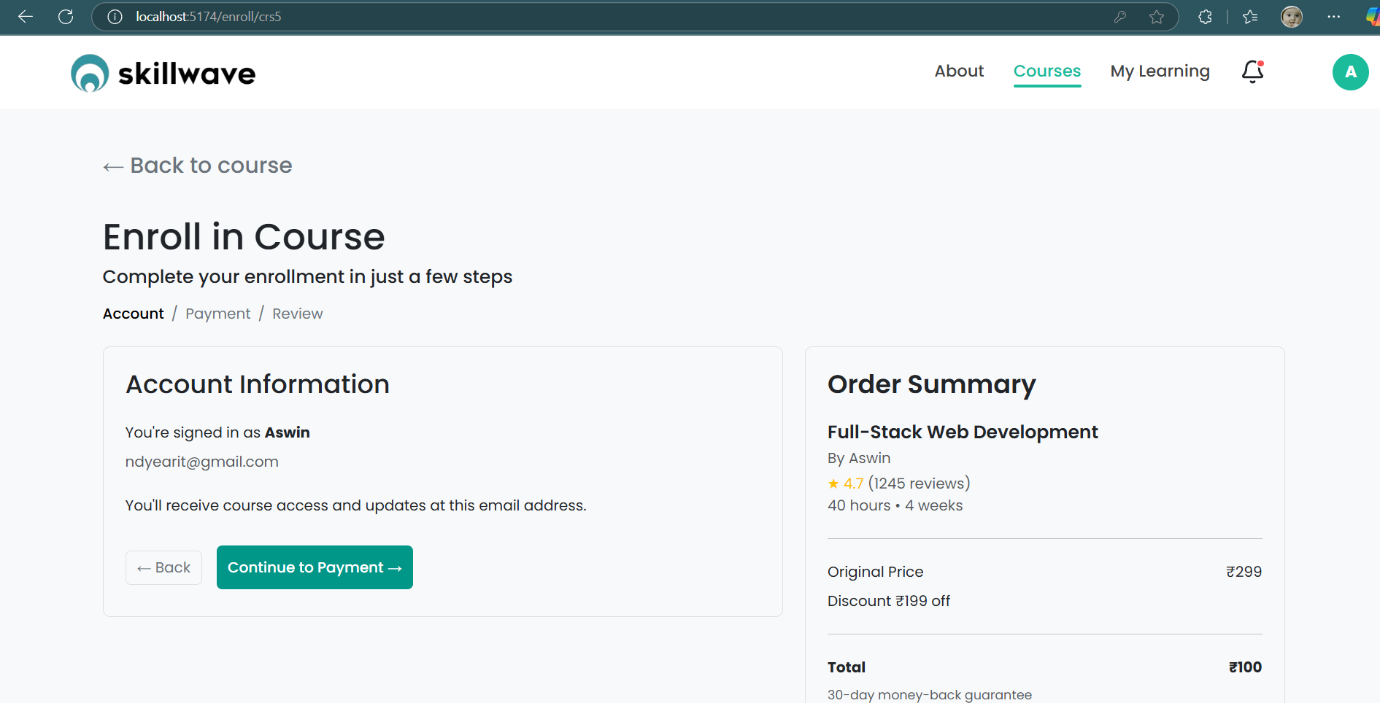
8. Course Enrollment Module:
Enables users to enroll in a selected course and initiates the learning path.

Slide 26
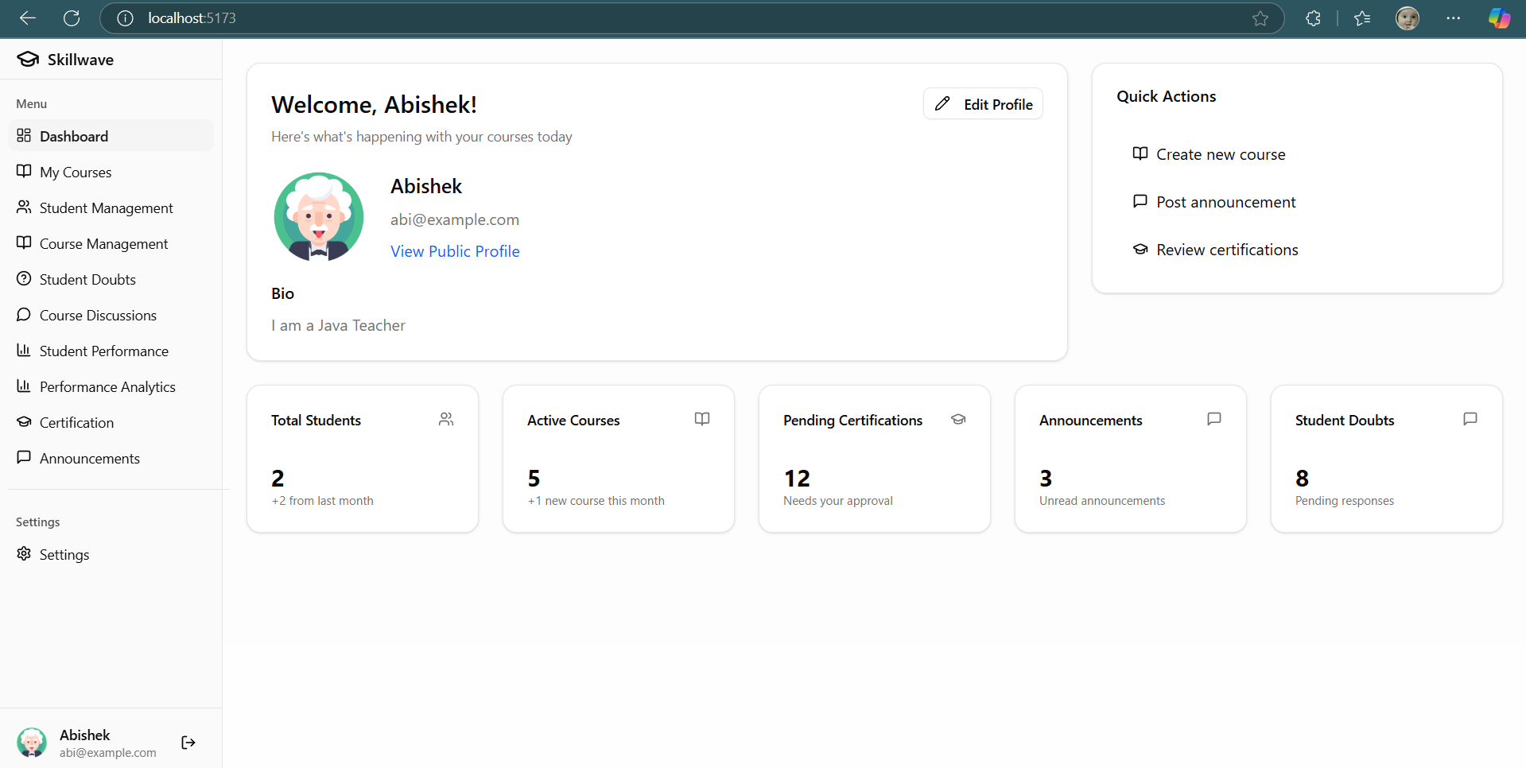
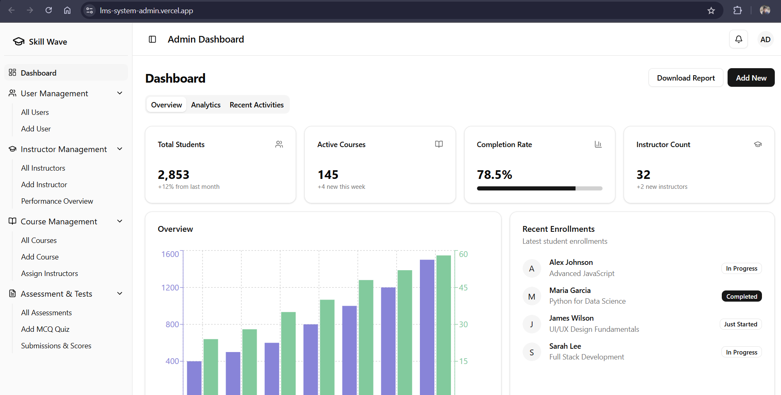
9. Teacher Dashboard and Admin Dashboard:
Teachers manage course content and student progress; admins oversee the whole system.

Slide 27
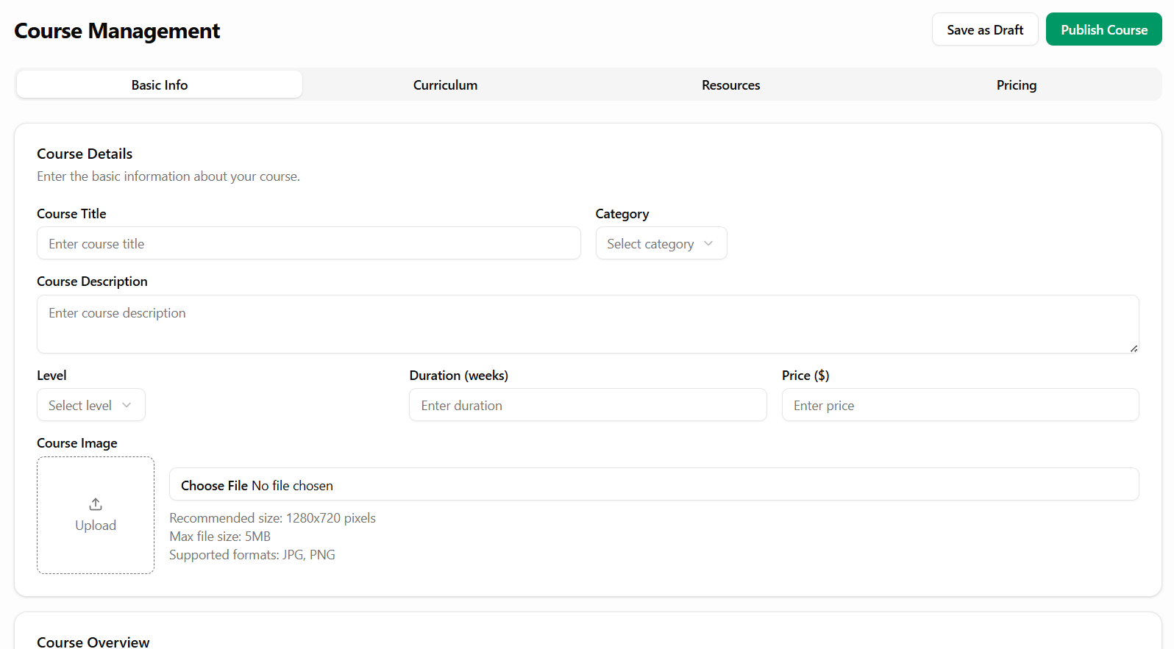
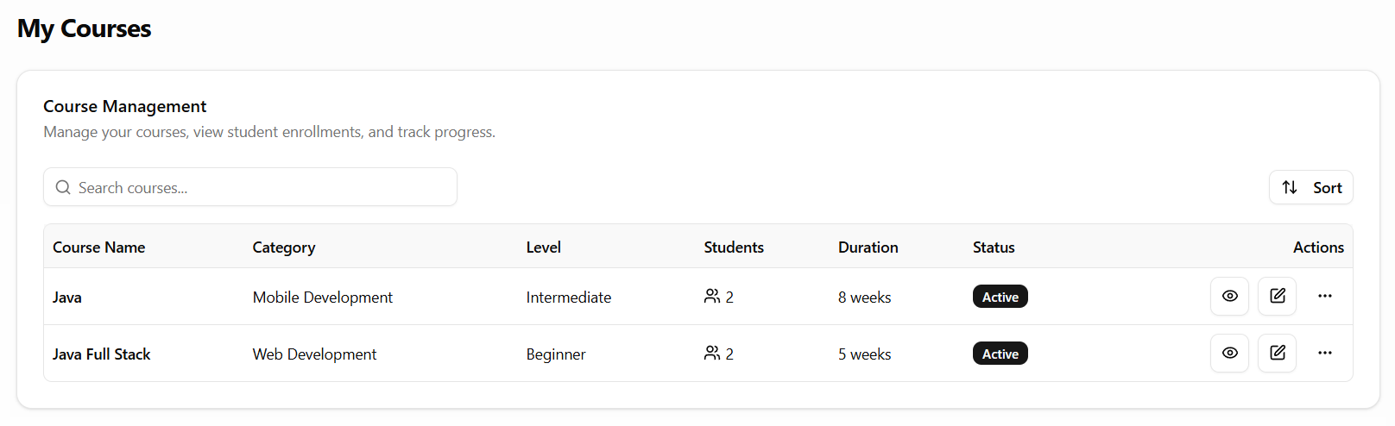
10. Course Management Module:
Teachers can create, edit, publish, or remove course content and materials.

Slide 28
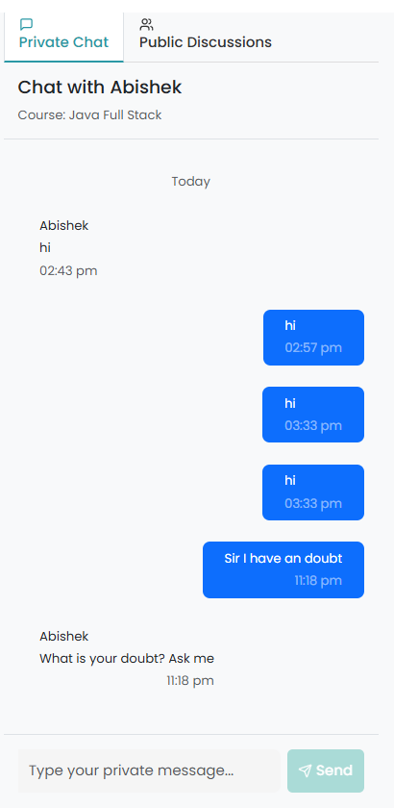
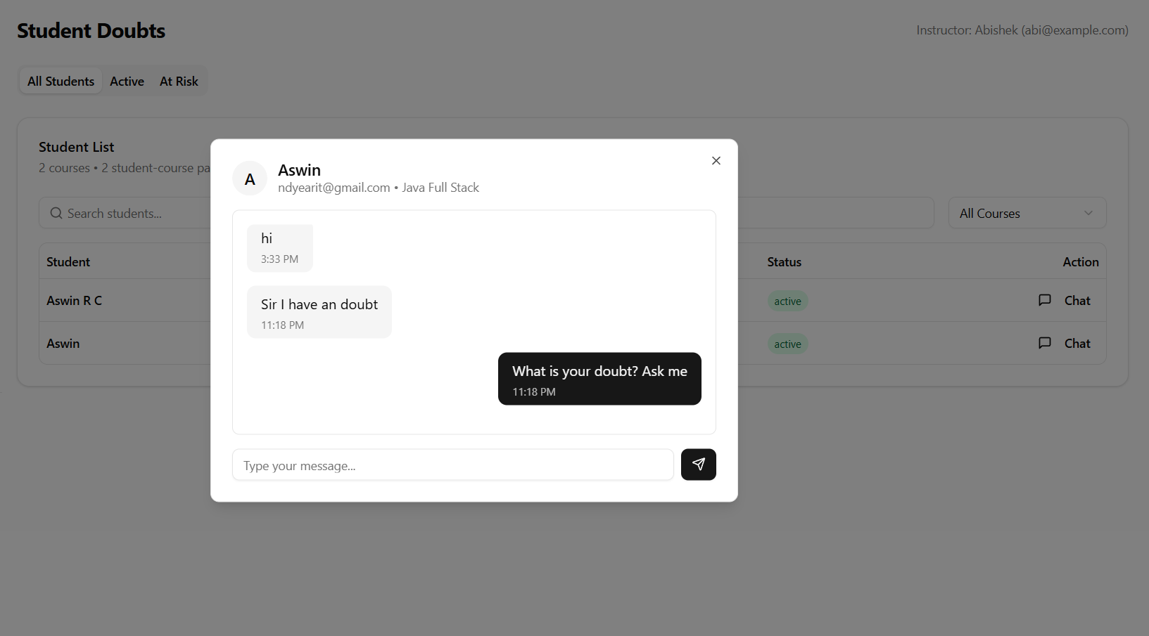
11. Chat with Instructors Module:
Allows real-time messaging or doubt clarification between students and instructors.

Slide 29
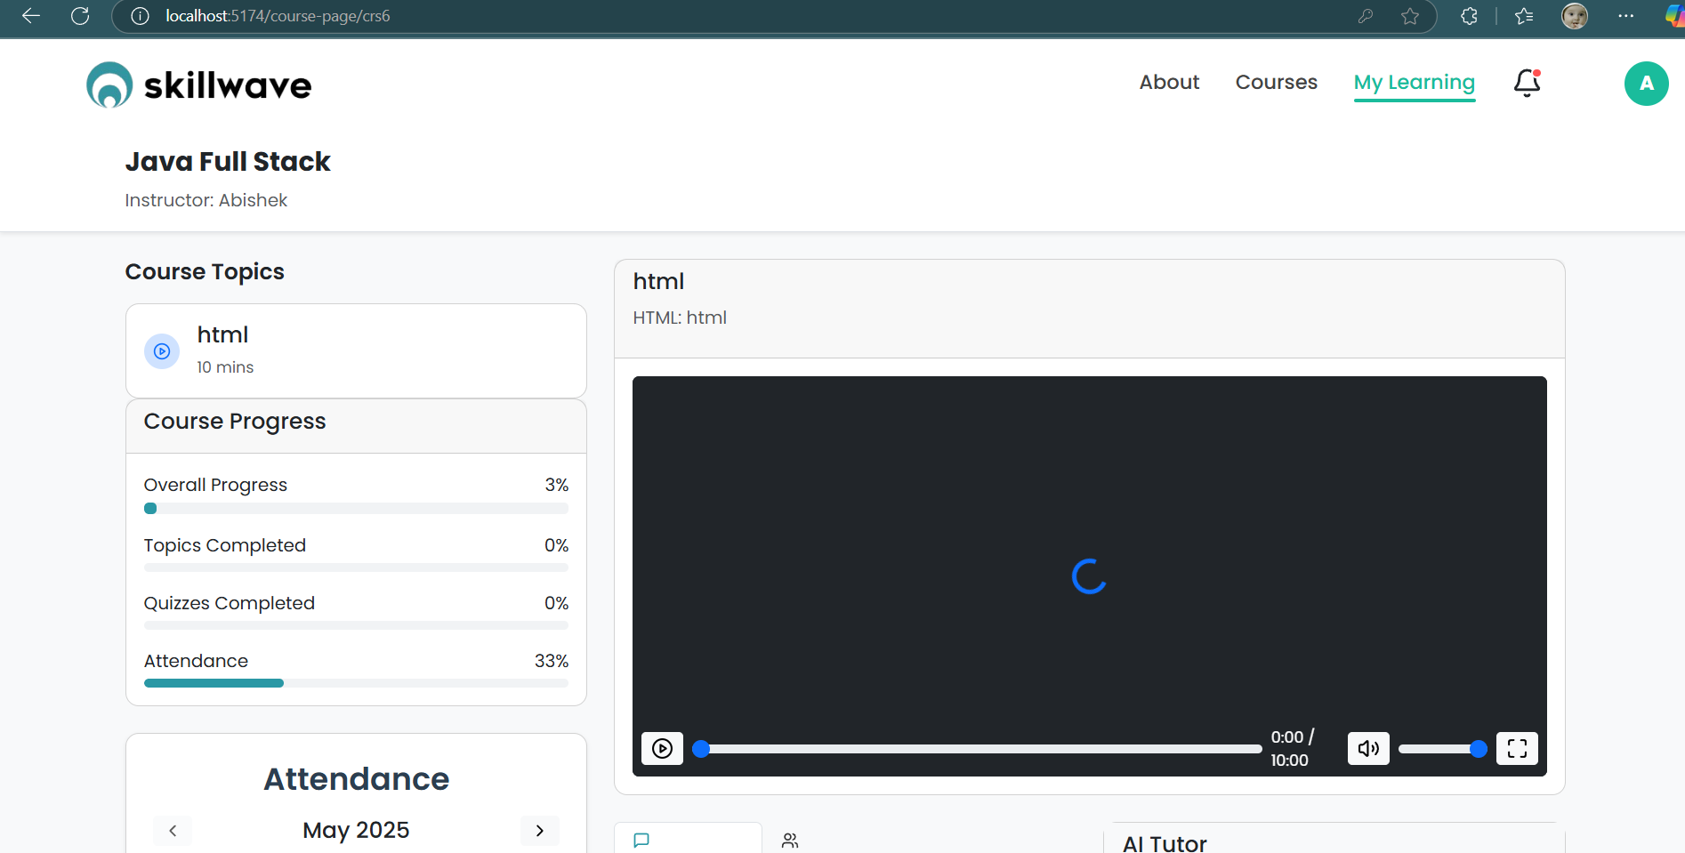
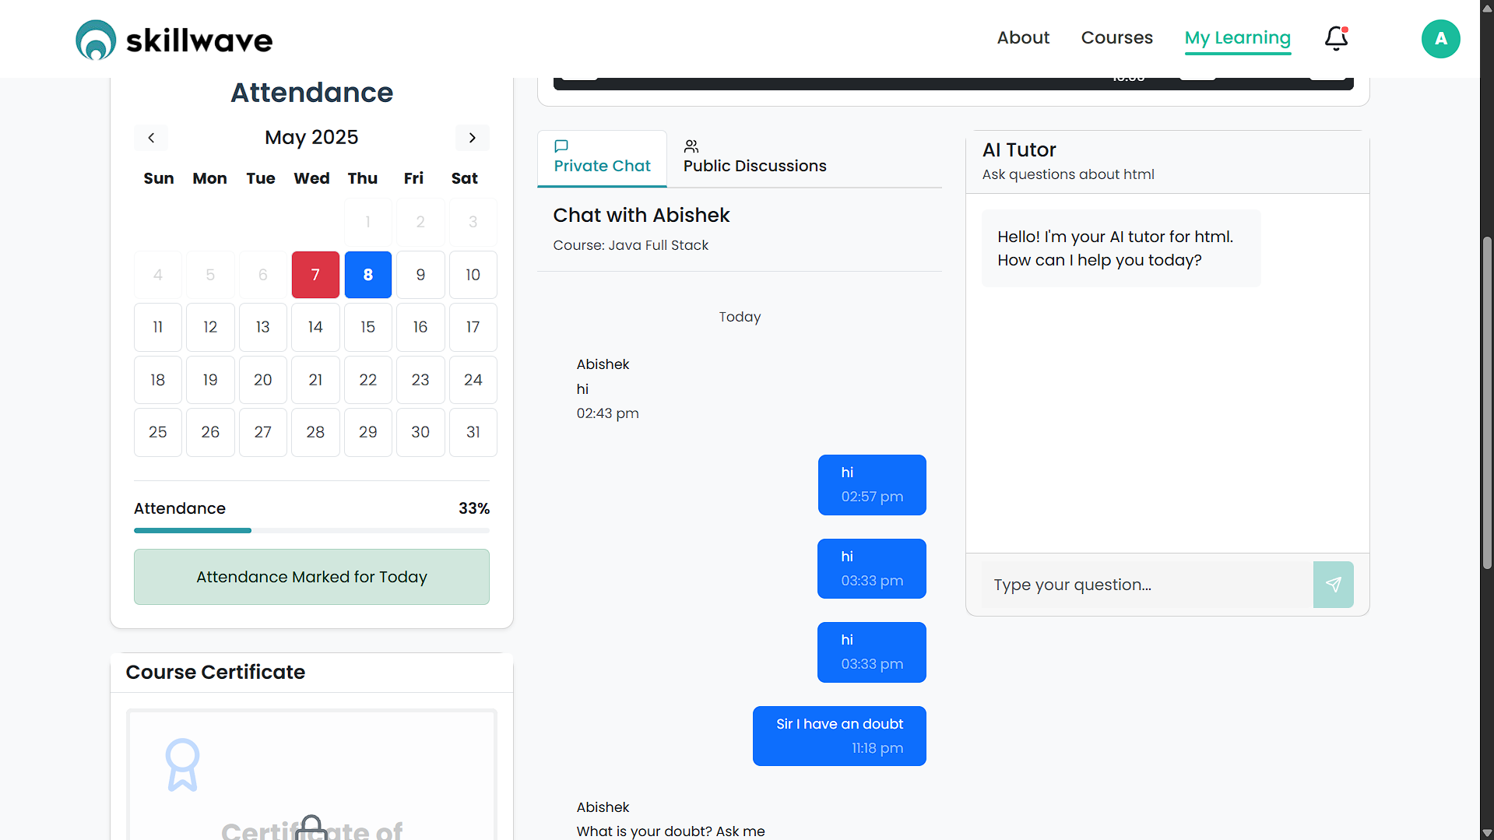
12. Course Learning Progress Module:
Tracks which videos, quizzes, or topics are completed and shows progress visually.
13. Attendance Tracking Module:
Automatically marks attendance based on course activity like video completion and quiz participation.
14. AI Tutor Module:
Provides 24/7 assistance by answering questions using Gemini API.

Slide 30
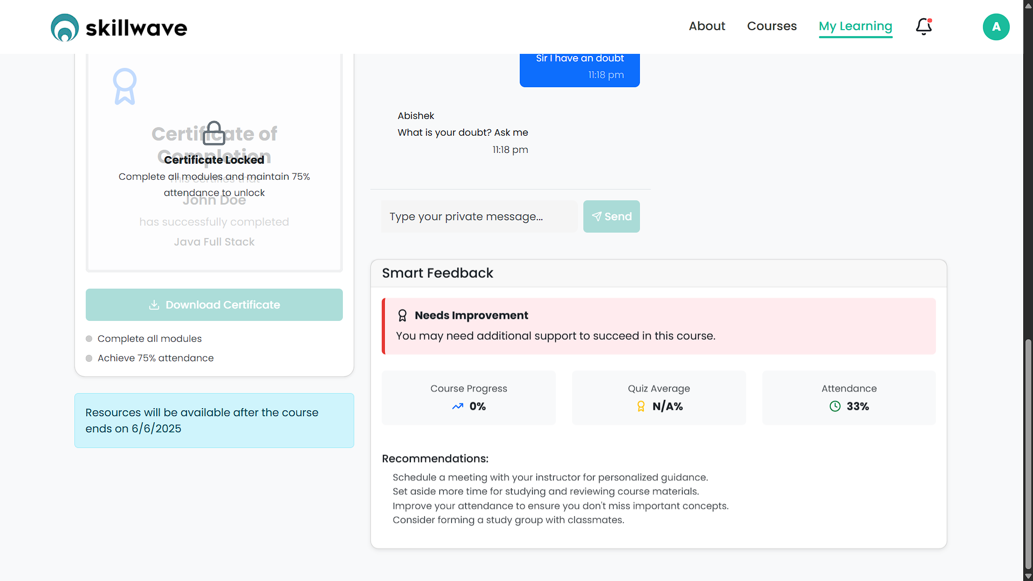
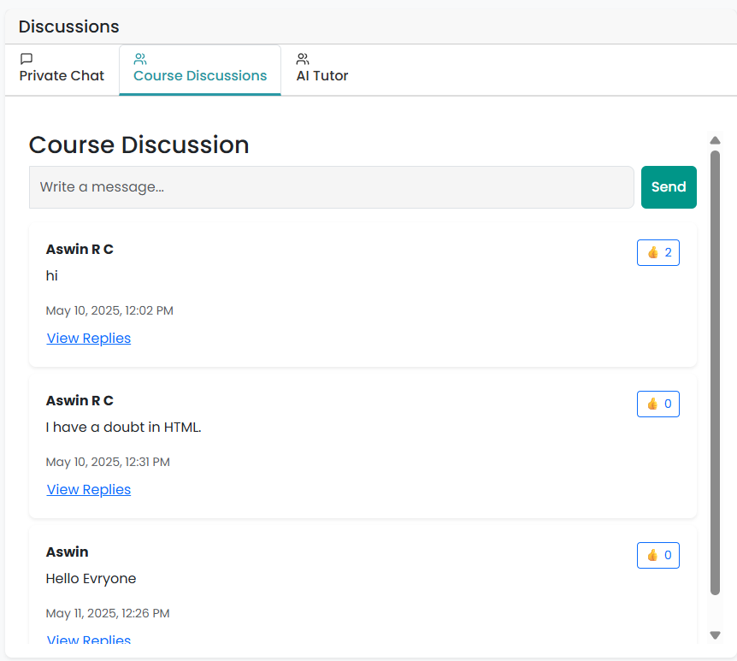
15. Certification and Smart Feedback Module:
Awards certificates upon course completion and gives smart learning feedback.
16. Course Discussion Module:
Facilitate communication between students and instructors for every course topic or lesson.

Slide 31
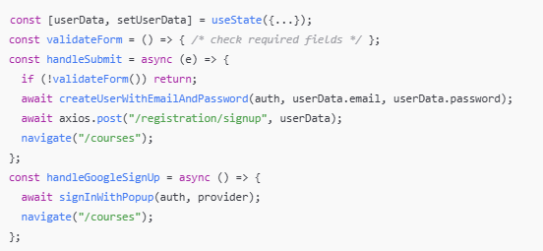
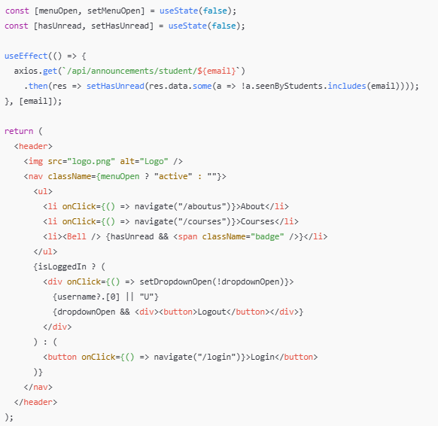
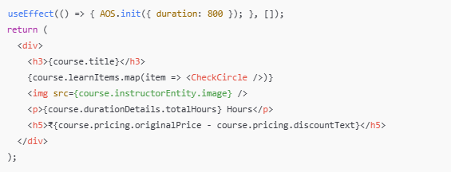
Sample Coding: Frontend code overview
SignUp.jsx
Navbar.jsx
Courses.jsx

Slide 32
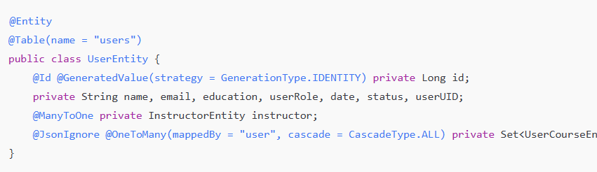
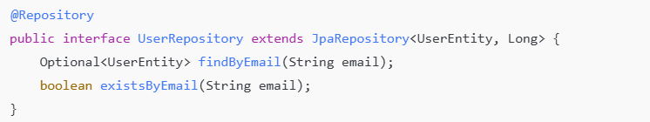
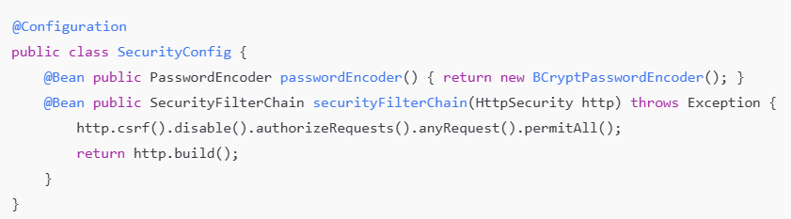
Sample Coding: Backend code overview
UserEntity.java
UserRepository.java
SecurityConfig.java

Slide 33
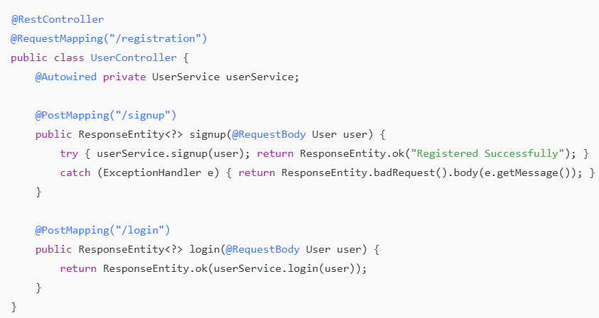
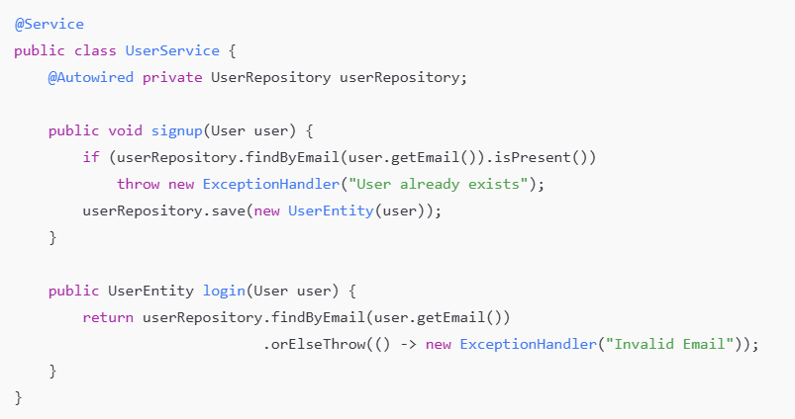
Sample Coding: Backend code overview
UserController.java
UserService.java

Slide 34
Conclusion
The evolution of LMS platforms shows a clear demand for smarter, more interactive learning experiences.
Traditional and modern systems offer core features but lack personalization, real-time feedback, and AI integration.
Our proposed LMS bridges this gap by:
Using AI-powered tutors for instant doubt-solving
Creating personalized learning paths
Providing smart analytics for progress tracking
Offering a unified platform for students and instructors
With these innovations, we aim to enhance engagement, efficiency, and learning outcomes for all users.

Slide 35
Future Work
Integration with Third-party Tools:
Support for Zoom, Google Meet, and GitHub to enhance collaborative learning and project-based courses.
Voice and Video Doubt Solving:
Implement real-time video/audio chat options between students and teachers for better doubt resolution.
Gamification Features:
Add badges, leaderboards, and achievement systems to boost learner motivation and course completion rates.
Multilingual Support:
Provide course materials and AI support in multiple languages to reach a broader audience.
Plagiarism Detection in Assessments:
Include tools to detect plagiarism in coding or written assignments to maintain academic integrity.

Slide 36
Reference
1. Aljawarneh, S. A. (2020). Reviewing and evaluating e-learning systems in higher education. Education and Information Technologies, 25(4), 3161–3177. https://doi.org/10.1007/s10639-020-10171-8
2. Graf, S., Liu, T. C., & Kinshuk. (2010). Analysis of learners' navigational behaviour and their learning styles in an online course. Journal of Computer Assisted Learning, 26(2), 116–131. https://doi.org/10.1111/j.1365-2729.2009.00336.x
3. Alenezi, A. (2021). A model for evaluating the effectiveness of AI-based Learning Management Systems in higher education. Computers, Materials & Continua, 67(2), 1769–1783. https://doi.org/10.32604/cmc.2021.013933
4. Bozkurt, A., & Sharma, R. C. (2020). Emergency remote teaching in a time of global crisis due to CoronaVirus pandemic. Asian Journal of Distance Education, 15(1), 1–6.

Slide 37
Reference
5. Holmes, W., Bialik, M., & Fadel, C. (2019). Artificial Intelligence in Education: Promises and Implications for Teaching and Learning. Center for Curriculum Redesign. Retrieved from https://curriculumredesign.org/wp-content/uploads/AI-in-Education.pdf
6. Zhang, D., Zhao, J. L., Zhou, L., & Nunamaker Jr., J. F. (2004). Can e-learning replace classroom learning?. Communications of the ACM, 47(5), 75–79. https://doi.org/10.1145/986213.986216
7. Coursera. (n.d.). How adaptive learning helps learners succeed. Retrieved April 21, 2025, from https://blog.coursera.org

Slide 38
THANK YOU

